Slide 1

UNIVERSITY COLLEGE OF ENGINEERING
OSMANIA UNIVERSITY
DEPARTMENT OF COMPUTER SCIENCE AND ENGINEERING
MAJOR PROJECT PRESENTATION
MAJOR PROJECT GUIDE
K. SHYAMALA MA’AM
PROFESSOR
HEAD OF THE DEPARTMENT
K. SHYAMALA MA’AM
PROFESSOR

Slide 2
DEEPFAKE DETECTION
PRESENTATION BY GROUP 4:
P. SRI SAI HARSHAVARDHAN 100518733037
P. TEJA 100518733039
K. SRIKAR RAGHUNATH 100518733050
UNDER THE GUIDANCE OF
PROF. K.SHYAMALA MA’AM
HOD OF CSE DEPARTMENT
UCEOU

Slide 3
AGENDA
Problem statement
Proposed architecture
Data pre-processing
Model Creation & Training
Testing the Model & Web App making
Conclusion and Future Scope

Slide 4
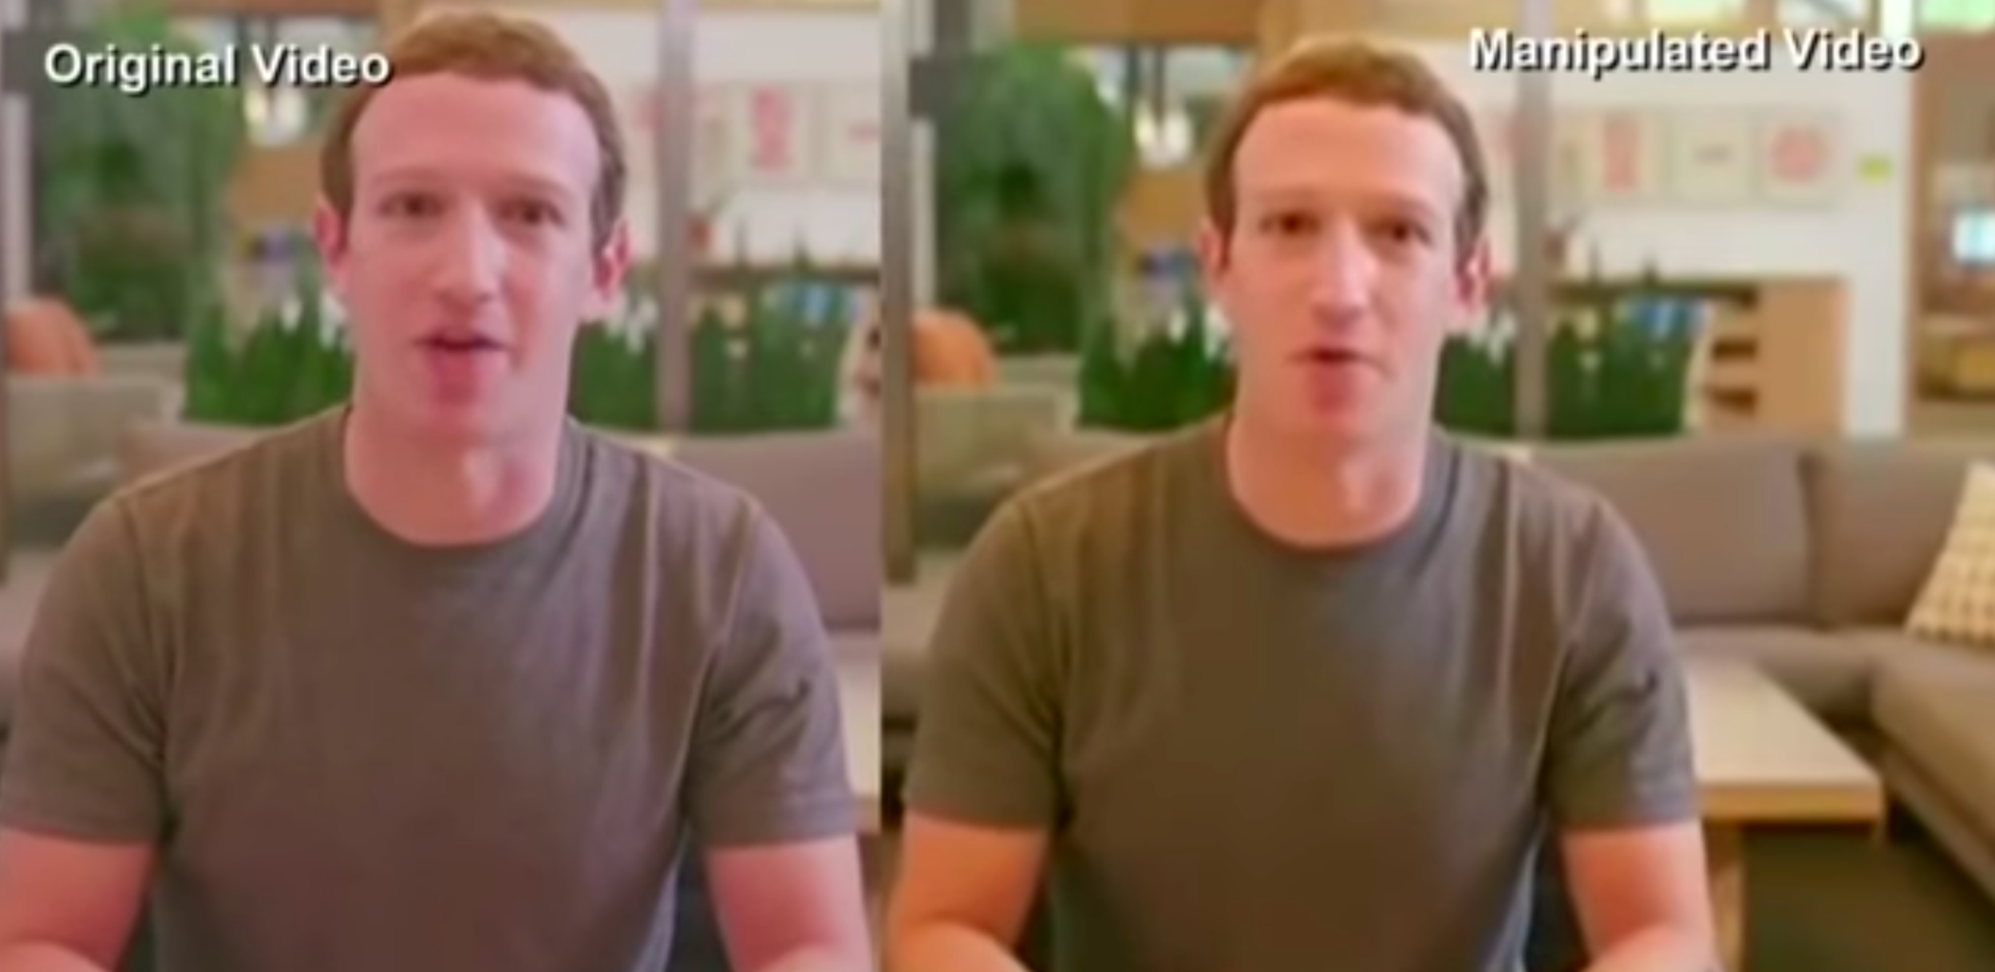
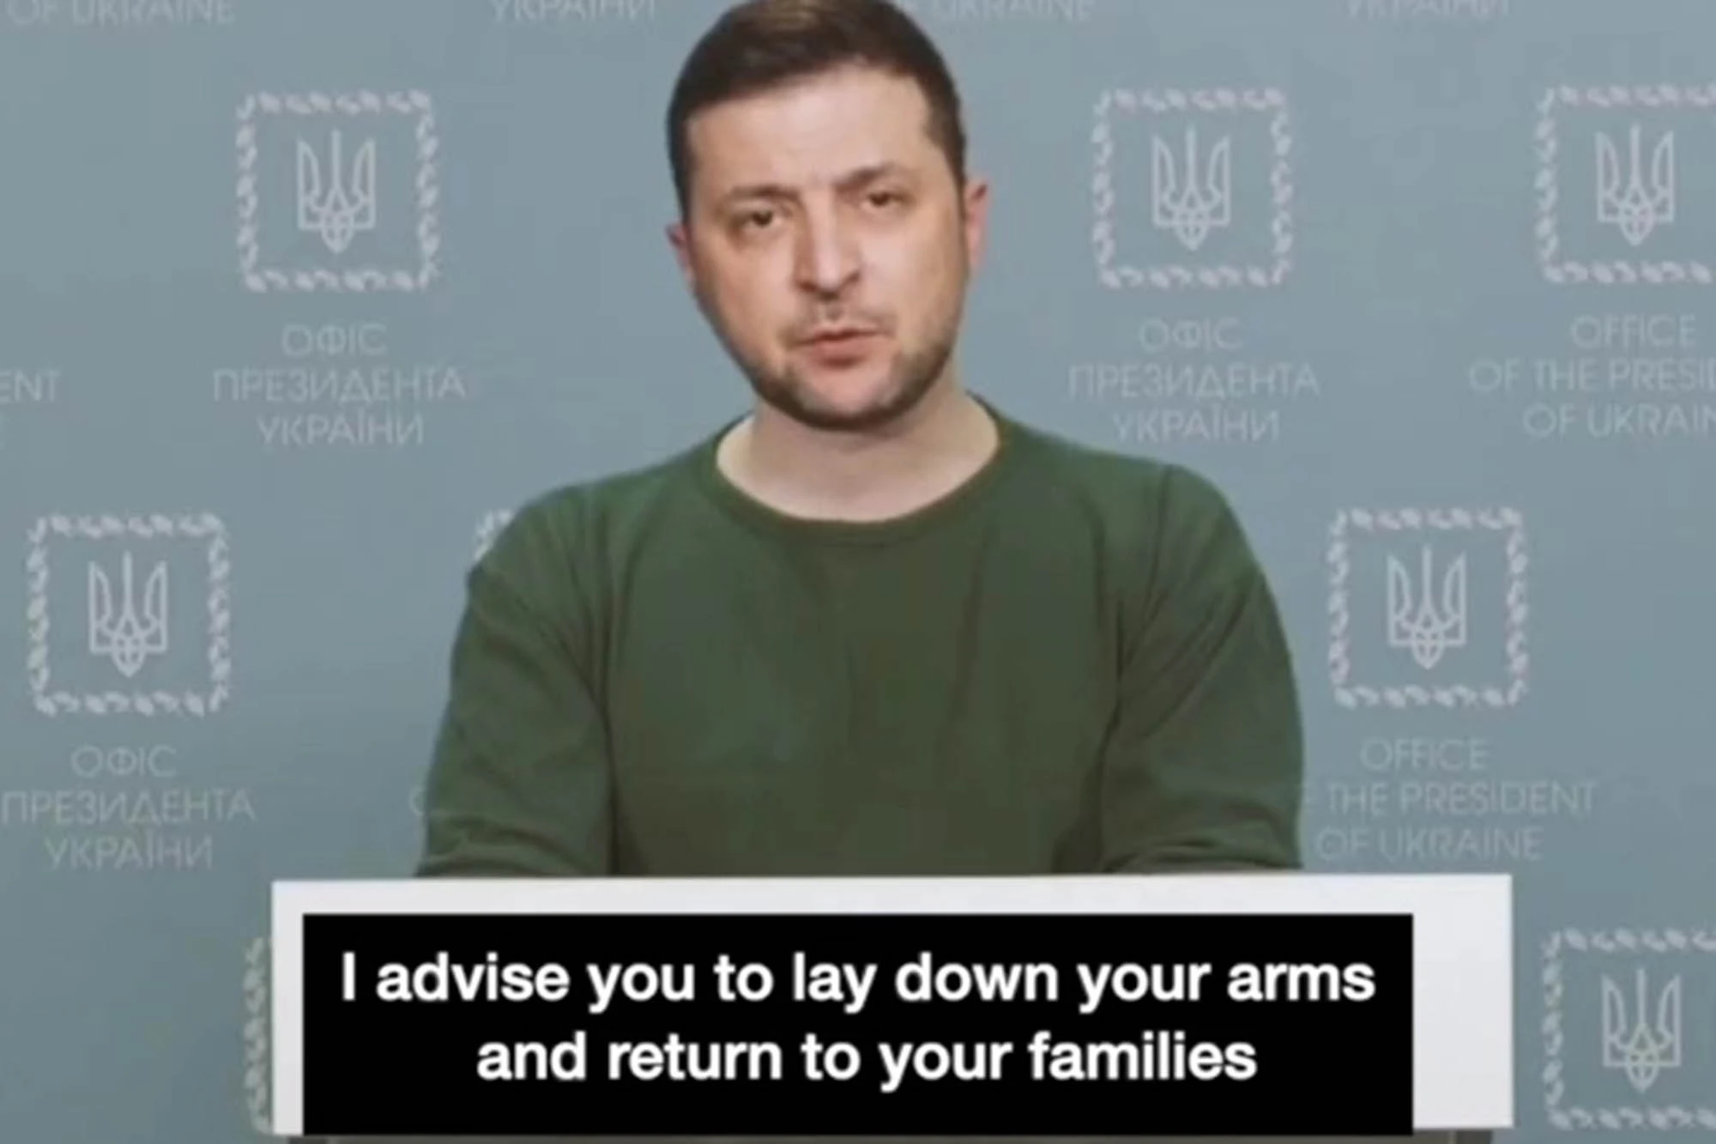
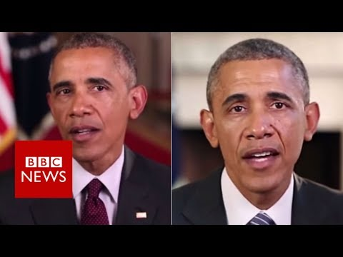
PROBLEM STATEMENT
Deepfakes can change the reality of audio visual content questioning their genuinity and our perception of truth. They pose a serious threat to the privacy of every human being, be it a famous politician or just a common man.
Hence we must try to devise a mechanism so that they can be detected with good amount of accuracy.

Slide 5
Information and its types
The dictionary meaning of information is facts provided or learned about something or someone.
However the very same facts can be falsely spread sometimes. Let us have a look at its types.
There are mainly three categories of information – Misinformation, Malinformation & Disinformation
Misinformation : This class of information happens mainly due to unintentional mistakes but yet false information is spread out.
Malinformation : This class of information is when true or real information is shared or spread but with a clear intent to harm your reputation or discredit a person.

Slide 6
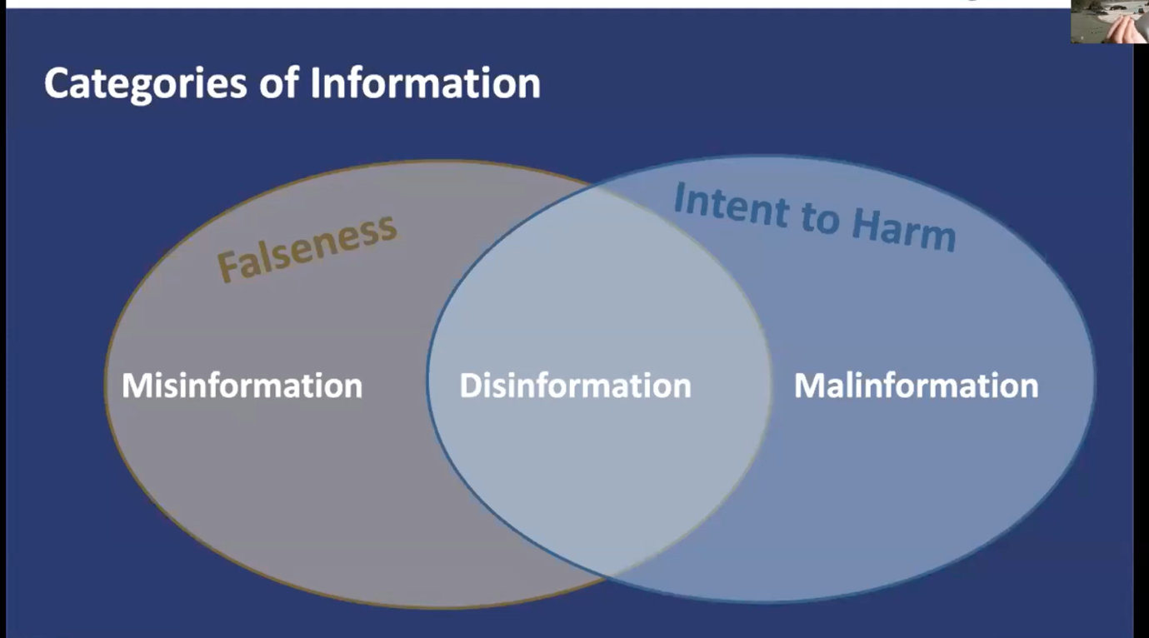
Continued…
Disinformation : At the intersection of the above two, we have disinformation. This is fabricated or deliberately manipulated audio visual content that are created intentionally to harm or discredit a person.

Slide 7
LITERATURE SURVEY

Slide 8
S.no | TITLE | AFFILIATION DETAILS | ABSTRACT | CONCLUSION
1 | CGFace- Deep Learning based Computer Generated Face Identification Using Convolution Neural Network | L. Minh Dang, Syed Ibrahim Hassan, Suhyeon Im, Jaechol Lee, Sujin Lee, Hyeonjoon Moon Published: 13 December 2018 Journal: Applied Sciences Volume 8 Issue 12 | To develop a novel decision support system for analyzing and detecting Computer Generated face images generated by the GAN network. A customised CNN architecture named CG Face model was developed which is specifically designed for the computer generated face detection task by customizing the number of convolution layers | The conventional image processing techniques rely heavily on observing and extracting handcrafted features. Hence it cannot be generalized. The proposed system CG face overcomes these challenges because it automatically extracts various abstract features
2 | Deepfakes: A New Frontier of Misinformation? | Kathryn Harrison, Deep Trust Alliance Posted: IFLA media | This is an international lecture given by Kathryn Harrison on deepfakes and various threats it poses | We can learn that deepfakes are an emerging form of threat posing serious issues to privacy.

Slide 9
S.no | TITLE | AFFILIATION DETAILS | ABSTRACT | CONCLUSION
3 | Unsupervised Representation Learning with Deep Convolutional GANs | Alec Radford & Luke Metz, Soumith Chintala Published: 7 Jan 2016 Journal: Conference paper at ICLR | We introduce a class of CNNs called deep convolutional generative adversarial networks (DCGANs), that have certain architectural constraints, and demonstrate that they are a strong candidate for unsupervised learning. | We propose a more stable set of architectures for training generative adversarial networks and show that adversarial networks learn good representations of images for supervised learning and generative modeling.
4 | MesoNet: a Compact Facial Video Forgery Detection Network | Darius Afchar, Vincent Nozick, Junichi Yamagishi, Isao Echizen Published: 4 September 2018 Journal: HAL open science | This paper presents a method to automatically and efficiently detect face tampering in videos. This paper follows a deep learning approach and presents two networks, both with a low number of layers to focus on the mesoscopic properties of images. | We provide two possible network architectures to detect such forgeries efficiently and with a low computational cost.
5 | In Ictu Oculi: Exposing AI Generated Fake Face Videos by Detecting Eye Blinking | Yuezun Li, Ming-Ching Chang and Siwei Lyu Computer Science Department, University at Albany, SUNY Published: 11 June 2018 Journal: IEEE Xplore | In this paper, authors describe a new method to expose fake face videos generated with neural networks. The proposed method is based on detection of eye blinking in the videos, which is a physiological signal that is not well presented in the synthesized fake videos. | LRCN takes advantage of long term dynamics to effectively predict eye state, such that it is more smooth and accurate.

Slide 10
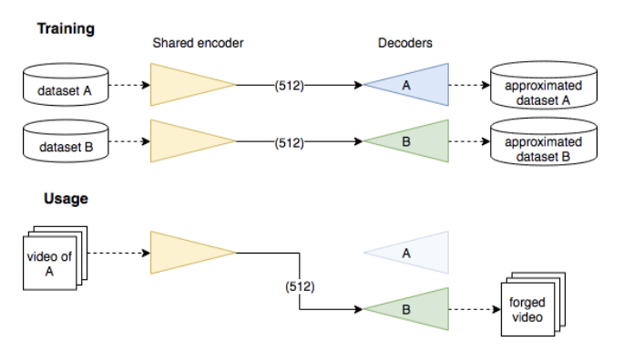
How deep fakes are generated
The trick consists in sharing the weights of the encoding part of the two auto-encoders EA and EB, but keeping their respective decoder separated.
The intuition behind this approach is to have an encoder that privileges to encode general information of illumination, position and expression of the face and a dedicated decoder for each person to reconstitute constant characteristic shapes and details of the person face. This may thus separate the contextual information on one side and the morphological information on the other.
The last step is to take the target video, extract and align the target face from each frame, use the modified auto-encoder to generate another face with the same illumination and expression, and then merge it back in the video.

Slide 11
METHODOLOGY
Despite the predominant effort of detecting face manipulation in still images, less attention has been paid to the identification of tampered faces in videos by taking advantage of the temporal information present in the stream.
While it is important to develop detectors to pick up those salient irregularities in still images, additional important features for detecting manipulations in videos are captured by the temporal coherence inherently present in a video stream.
Recurrent convolutional models are a class of deep learning models which have proven effective at exploiting the temporal information from image streams.
We thereby want to come up with the best strategy for combining variations in these models to obtain good performance .
Specifically, we attempt to detect Deepfake, Face2Face and FaceSwap tampered faces in video streams.

Slide 12
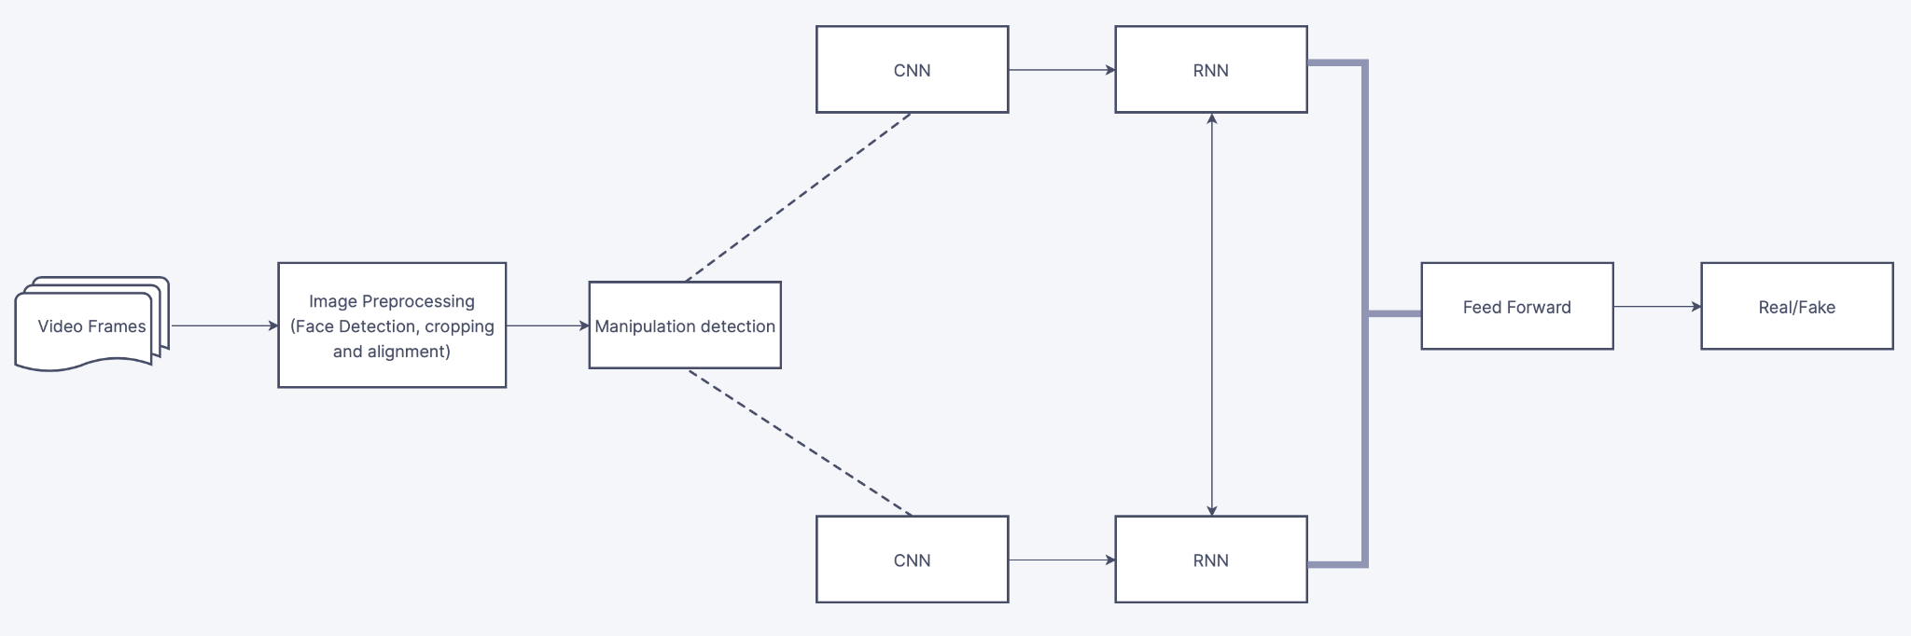
PROPOSED ARCHITECTURE

Slide 13
DATASET PREPARATION
For datasets, we are using a Deepfake Detection challenge dataset from Kaggle linked here combined with Face Forensics++ and Celebrity Deepfake
The whole dataset is about 54 GB consisting a mixture of deepfake and real videos. The datasets were arranged so that there was no bias between fakes and real videos.
The average size of actual video is about 8.5 MB with an average frame per video as 147.6.
The average size of the preprocessed video is about 300kb
The dataset had a metadata.csv file and contained data in the format {“Name.mp4” :{“label”:”fake”, ”split”:”train”, ”original”:original_video},....} which we have converted to csv to just Name and Label.
We have preprocessed a total of 6000 videos and stored in the google drive.

Slide 14
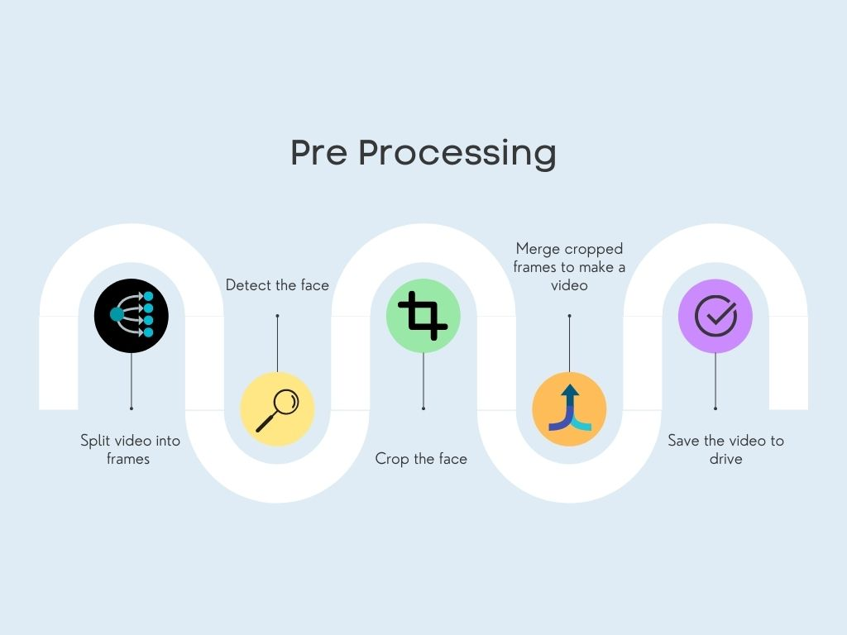
ROADMAP FOR PRE-PROCESSING

Slide 15
Preprocessing Data
Dataset preprocessing includes splitting the video into frames at 30fps. Followed by only human face detection and cropping the frame with the detected face.
To maintain the uniformity in the number of frames the mean of the dataset video is calculated and the new processed face cropped dataset is created containing the frames equal to the mean.
The frame size is taken to be 112x112 with a motion jpeg code to compress the frame
The frames that don’t have faces in them are ignored during preprocessing.
We generate a video with 150 frames i.e 5 second video cropped to face and save it into the google drive
Note: GPU acceleration (via nvidia’s CUDA library) is required for good performance with this model.

Slide 16
Data Input
The data is read directly from the google drive mounted on colab and the videos which have less than 100 frames are removed.
We have split the data as training and test in 70:30 ratio with no bias in real and fake videos, here the fake videos are classified with a label of 0 and real videos are classified with a label of 1. This made 1800 test videos and 4200 training videos.
We have created a metadata.csv file which has the following columns: video name, label which helps us verify our prediction
The sequence length we have used in this application for processing the data is 10,20,40,100 frames which will be sent into the model for training and can be varied.
The input has the following dimensions: (B X S X 3 X 112 x 112), where S signifies the sequence length per video and B signifies batch size of the videos.

Slide 17
Transformations
Transforms are common image transformations available in the torchvision.transforms module. They can be chained together using Compose.
We apply the following transformations on the input frames:
Convert to PIL image
Resize the image to 112x112
Convert it to a tensor
Normalize the image with a mean of [0.485, 0.456, 0.406] and standard deviation of [0.229, 0.224, 0.225].

Slide 18
Dataset Class
We create a function called video_dataset which inherits torch.utils.data.Dataset which is an abstract class representing a dataset. It overrides:
__init__ which initializes the class
__len__ so that len(dataset) returns the size of the dataset.
__getitem__ to support the indexing such that dataset[i] can be used to get ith sample, this is memory efficient because all the images are not stored in the memory at once but read as required.
In the __getitem__ class we return the required sequence of frames after applying the transformations mentioned in the previous slide

Slide 19
Dataloader Class
torch.utils.data.DataLoader is an iterator which provides the following features:
Batching the data
Shuffling the data
Load the data in parallel using multiprocessing workers
The Dataloader class requires the input to be an instance of the Dataset class.
We use a batch size of 4, shuffle the data and set the number of workers to 4 which is used to put data simultaneously into RAM.
Please be aware that excessive worker creation might get DataLoader running slow or even freeze, lower the worker number to avoid potential slowness/freeze if necessary.

Slide 20
Transfer Learning with Resnext
Transfer learning generally refers to a process where a model trained on one problem is used in some way on a second related problem.
A neural network model is first trained on a problem similar to the problem that is being solved. One or more layers from the trained model are then used in a new model trained on the problem of interest.
In this particular application we have used ResNeXt, the ResNeXt architecture is an extension of the deep residual network which replaces the standard residual block with one that leverages a "split-transform-merge" strategy (ie. branched paths within a cell) used in the Inception models.
It has 50 layers in total with 32 paths with 4 out channels.

Slide 21
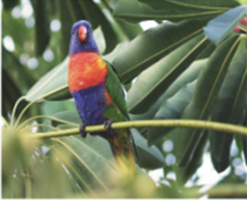

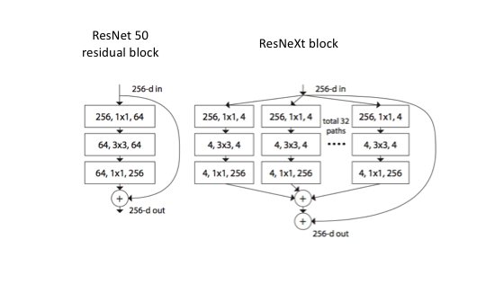

Slide 22
Model Creation
For the purpose of creating model, we have employed the torch and torchvision libraries of python.
We have defined a class that inherits from the nn module of torch which is the base class for all the neural networks. We have then defined the constructor with required layers.
The model, as planned in phase 1, uses a CNN model for feature extraction i.e the resnext model available as a pretrained model in the torch module.
We cut out the last 2 layers of resnext model and use remaining network to append the rest of model
Upon the resnext, we have added an Average Pooling layer.

Slide 23
Continued…
We have then added an LSTM layer with 1 layer holding LSTM cells.
We have then sent the output of this LSTM to Sequential model where input to the model is from 2048 neurons and output is two classes followed by a dropout layer with rate=0.4
Finally all the layers are connected in the forward() method of Model class.

Slide 24
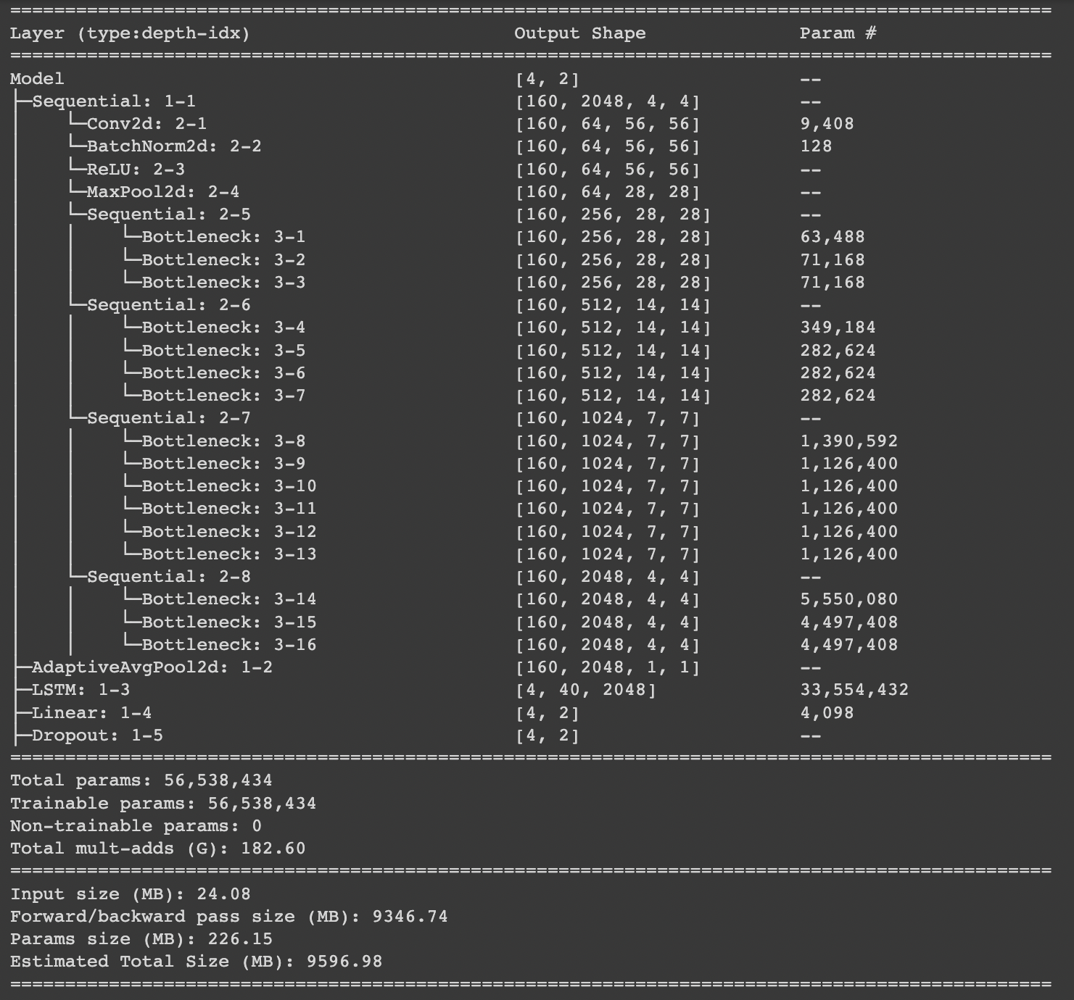

Slide 25
Training the Model
To train our model, we first instantiate the class with output classes as 2 and return the model in CUDA memory using .cuda() method
Since CUDA memory is extremely useful we have to train the model in GPU runtime environment as opposed to a normal CPU version.
We have defined a train_epoch(data_loader, model, criterion, optimizer) method to train the model. We are performing batch-wise operations here with batch size being 4.
Inside the method we first set model to trainable phase.
We iterate over the training data one by one video.
For every video, we insert the target and and inputs to CUDA memory first.
We then call the model on the inputs and get predicted output. This indirectly calls on the forward method of Model class.

Slide 26
Continued…
With help of criterion which is the loss function- we get loss by calculating Cross Entropy.
loss.backward() computes the derivative of the loss w.r.t. the parameters (or anything requiring gradients) using backpropagation.
optimizer.step() causes the optimizer to take a step based on the gradients of the parameters. We are using an Adam optimizer with learning rate = 0.00001 and decay rate to be 0.00001
Hence for the video losses are calculated and all hyperparameters are tuned accordingly.
After training the model for a whole epoch , we are saving the state of the model using torch.save() with name checkpoint.pt
This process is run for a whole of 20 epochs.
This model can be directly imported next time we want to predict on an unknown video.

Slide 27
Testing
We loaded the model ( about 216 mb) into colab and performed testing.
With the trained model and the data set and with the given criterias we go forward with the testing process.
For this we first set model.eval() which is defined as a process to evaluate the train data. The eval() function is used to evaluate the train model. The eval() is type of switch for a particular parts of model which act differently during training and evaluating time.
we load the targets and inputs into cuda and get the values 0 and 1.
finally depending on this form output , we detach cuda memory and add value to list.
We got results of confusion matrix as True positive= 855, True Negative= 819, False Positives= 81, False Negatives= 45.
Finally the accuracy is predicted which came out to be 93% when we tested taking 40 frames as sequence length and 20 epochs.

Slide 28
Web App
The web app is built using HTML, CSS, Javascript for frontend and Flask for backend.
Flask is a micro web framework written in Python. It is classified as a microframework because it does not require particular tools or libraries. It has no database abstraction layer, form validation, or any other components where pre-existing third-party libraries provide common functions.
Flask is based on the Jinja2 template engine.
We store all the uploaded videos, css files, js files, images to a static folder and all the html files into a templates directory

Slide 29
Integrating web app and colab
The flask code that we run on google colab is internally executed on its virtual machines locally with a private IP which can’t be accessible to users outside the VM.
To expose this IP to public we use a library called flask_ngrok.
Ngrok is a useful utility to create secure tunnels to locally hosted applications using a reverse proxy. It is a utility to expose any locally hosted application over the web.
With the help of the public url we can now access our web application and interact with it.

Slide 30
Web App flow

Slide 31
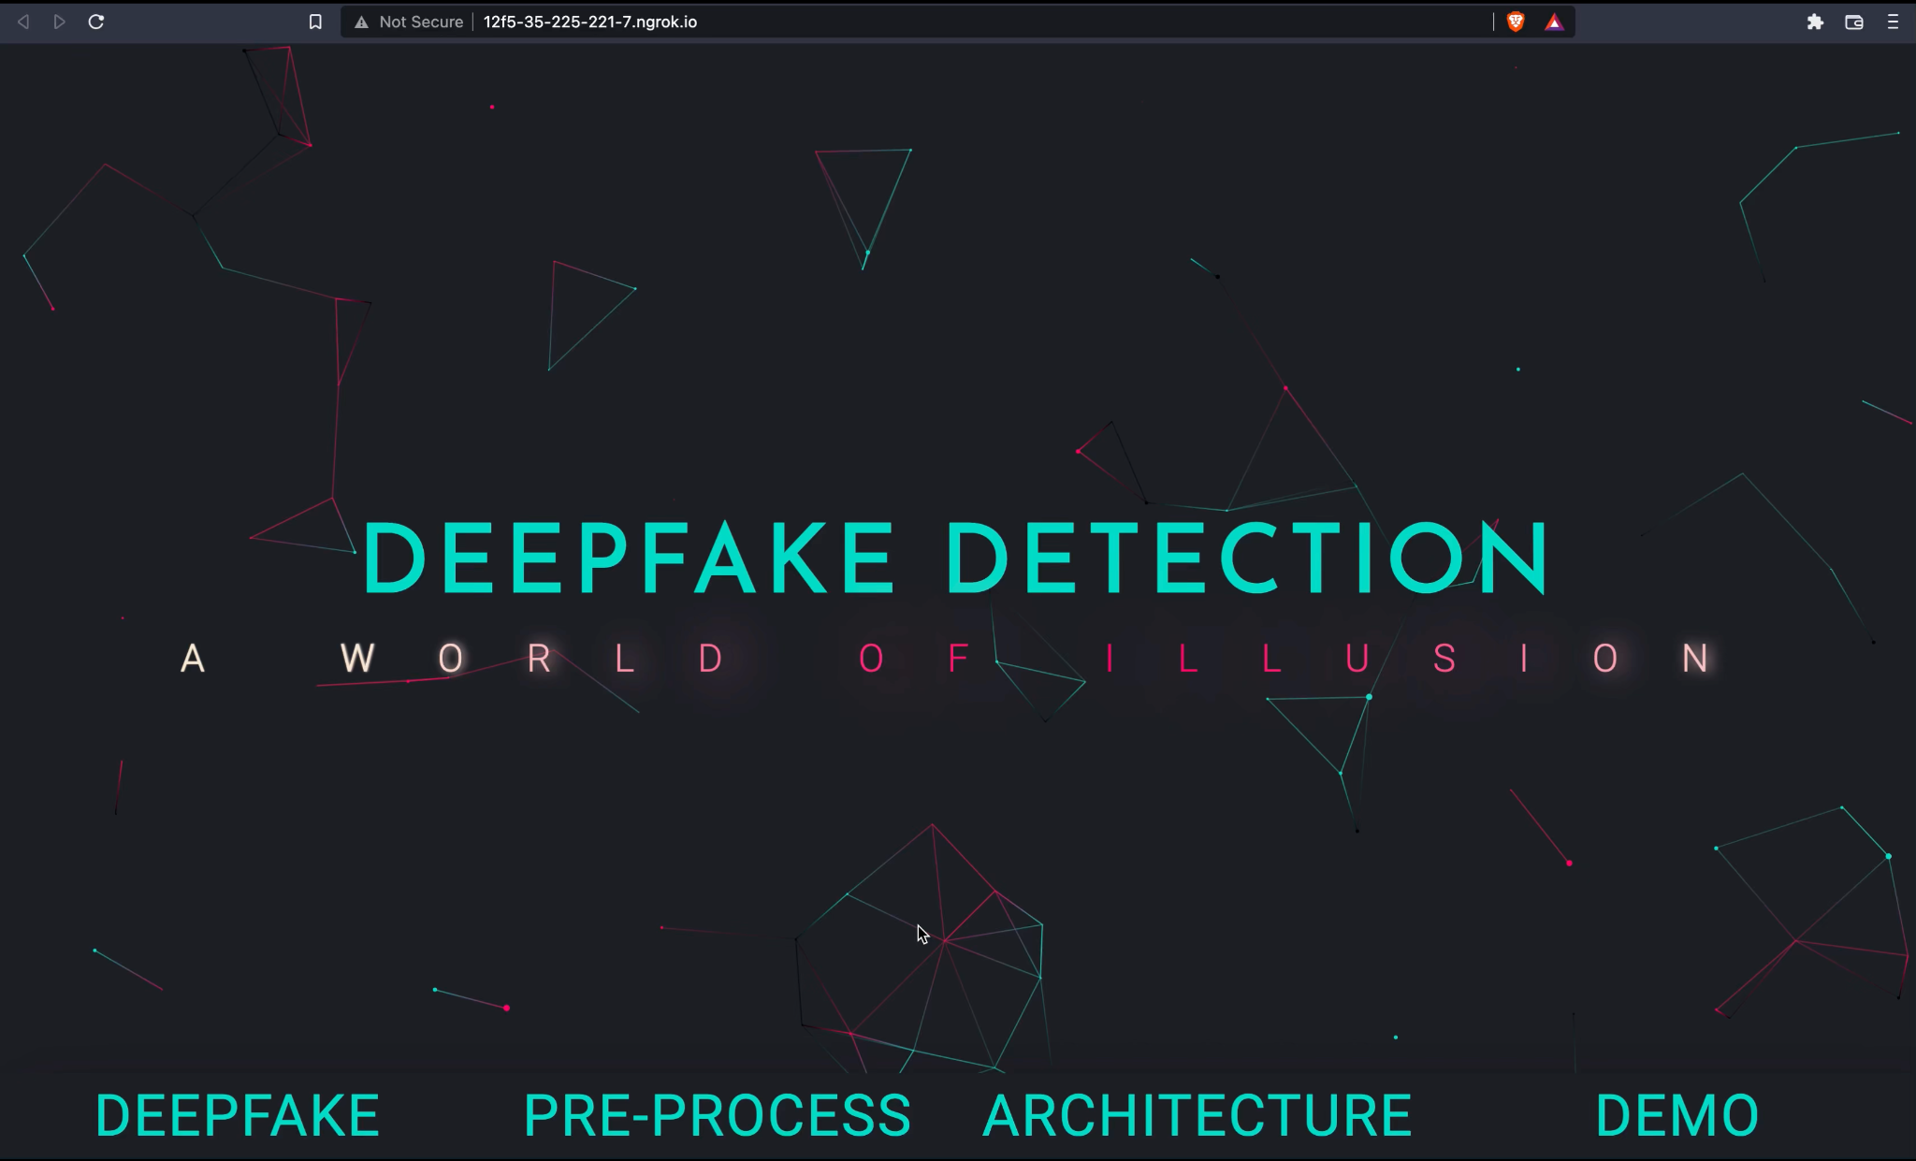

Slide 32
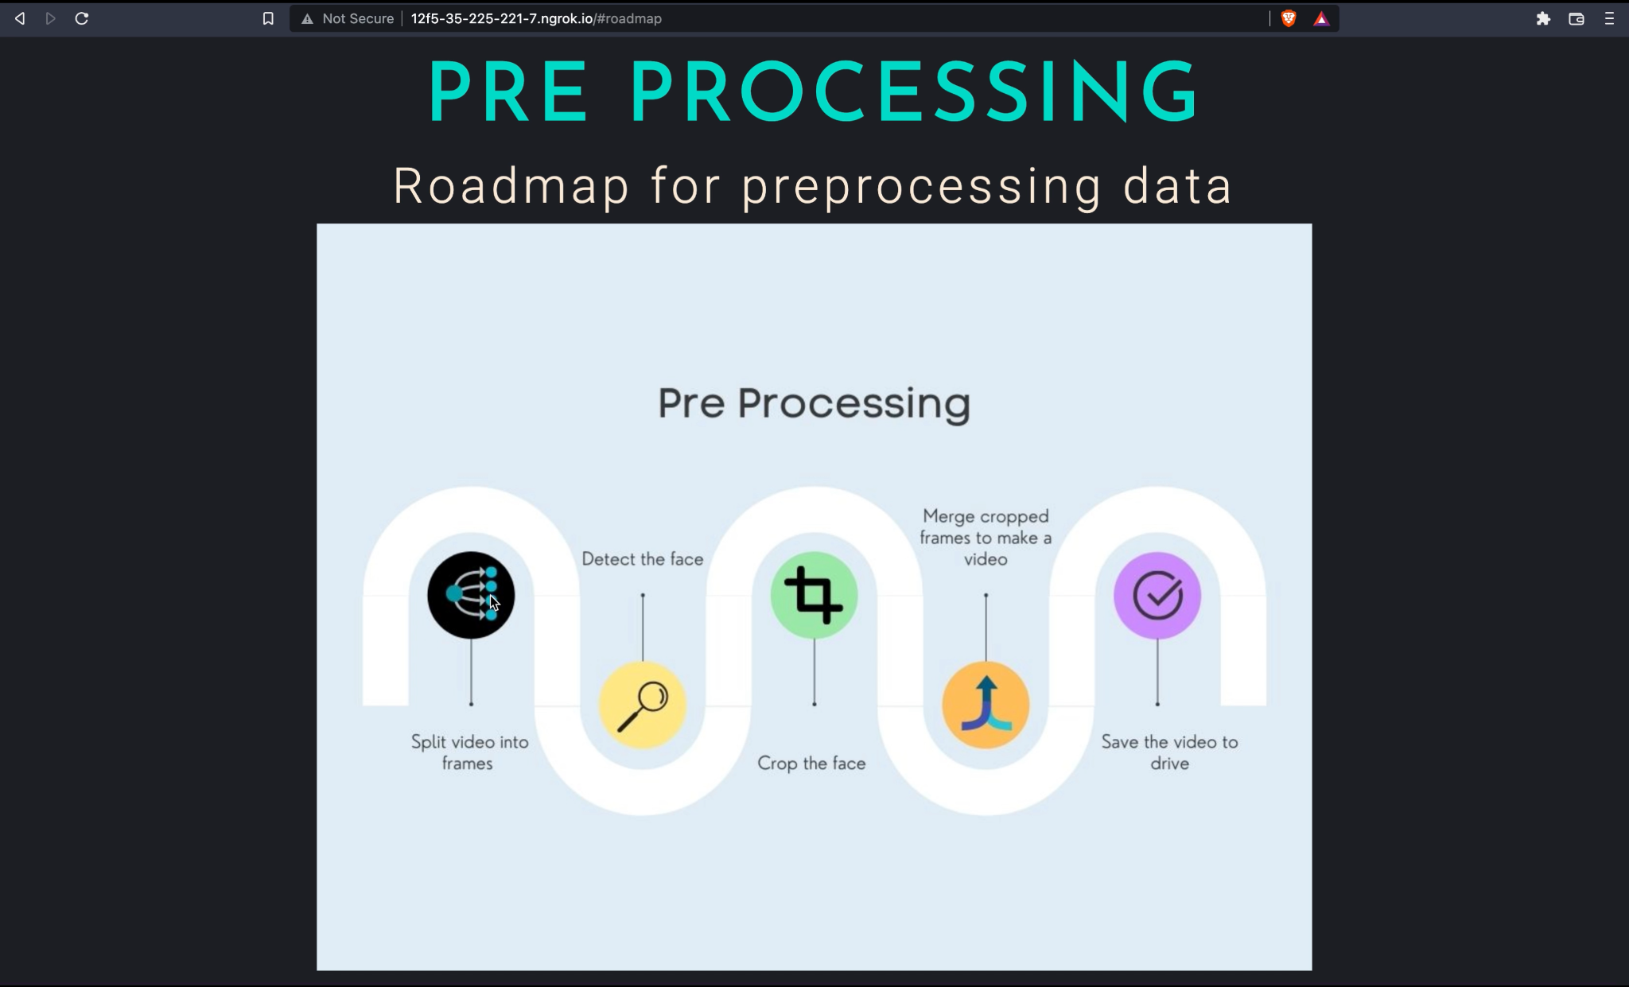

Slide 33
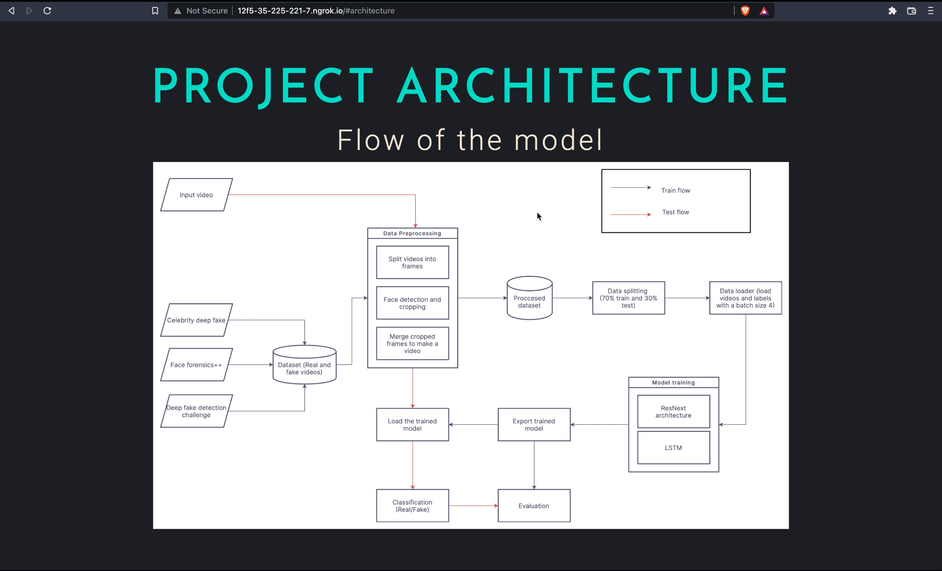

Slide 34
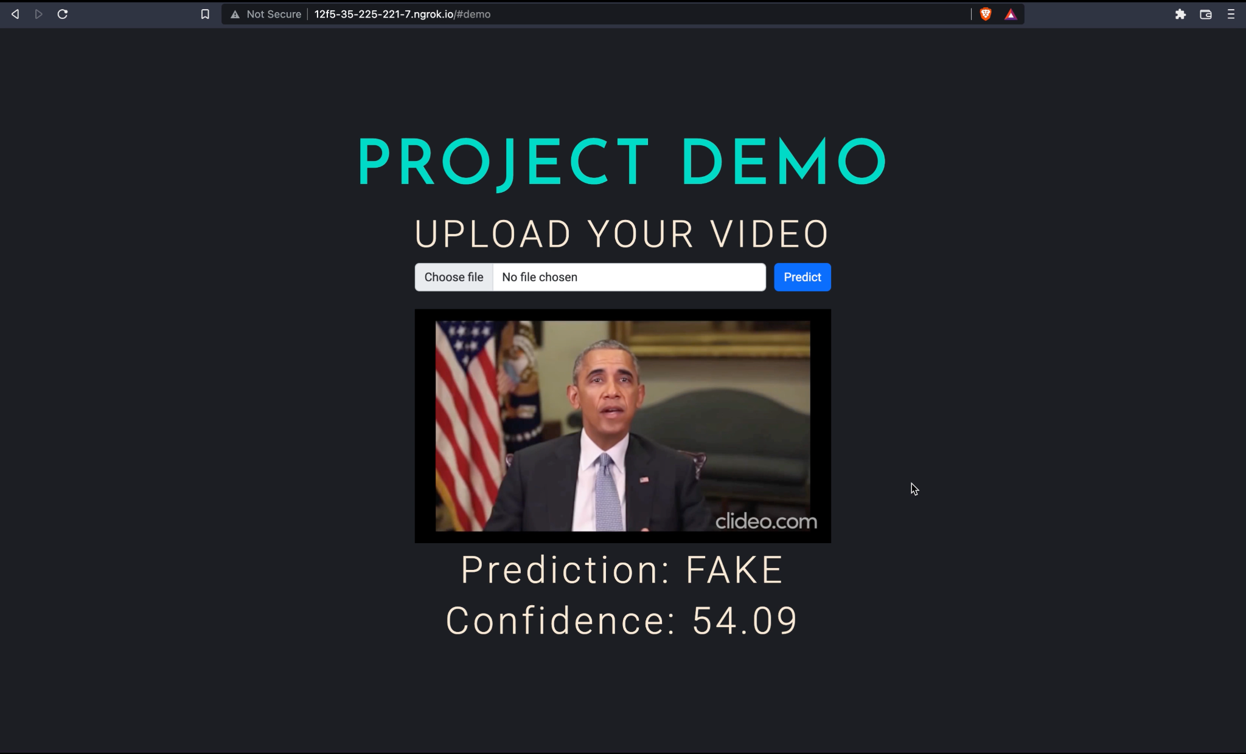

Slide 35
PROJECT DEMO

Slide 36
CONCLUSIONS
As planned, the project has executed the said model by making use of CNN model called Resnext, LSTM to find temporal inconsistencies between frame to frame.
The preprocessing and training took most of time since they are very compute intensive functions. The project has used a total of 6000 videos from various sources maintaining a balance between real and fake videos so that model does not undergo bias.
Finally this Project has come up with an overall accuracy of 93% using 40 sequence length.

Slide 37
Future Scope
Any project can be improved in future and on the same lines, we expect that the project can see improvements in future.
Also the hyperparameters can always be tuned for higher accuracy since it is experimentation process.
Instead of passing just face cropped video, one can send in the whole video while training which can detect full body deepfakes.
The project can also be extended for multiple faces in a single video
We can even capture background information’s inconsistencies instead of just focussing on the facial features.

Slide 38
THANK YOU.

